Slide 1
Smart Farming
presented by Group Xian
29.7.2023

Slide 2

Introduction
Smart Farming is a useful way to improve plants and crops health.
Smart Farming helps farmers to identify plants and crops diseases and other problems earlier.

Slide 3
Primary goals
Better productivity in farming systems.
Reduction in food prices
Decrease in pollution
Better decisions and knowledges for farmers and other associated people

Slide 4
Team Members
Ma Hsu Wint Hlwar (login, design and product section)
Mg Wai Lin Aung (login, design and knowledge sharing)

Slide 5
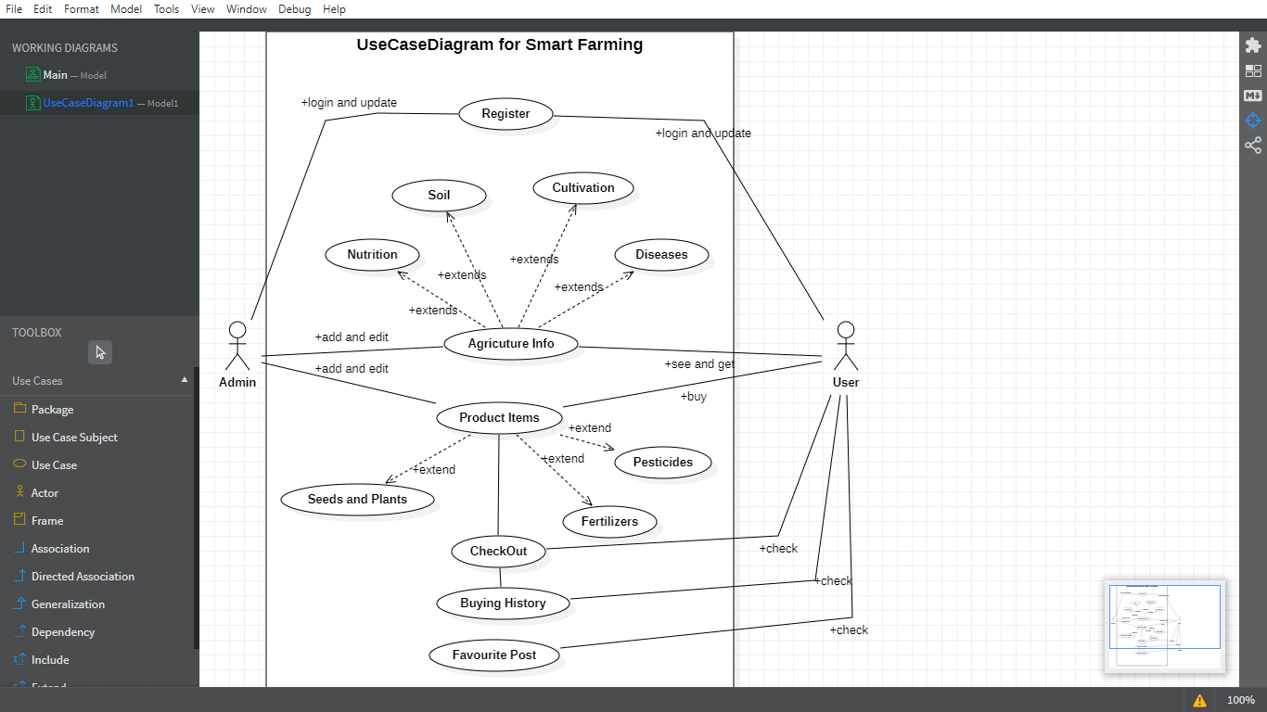

Slide 6
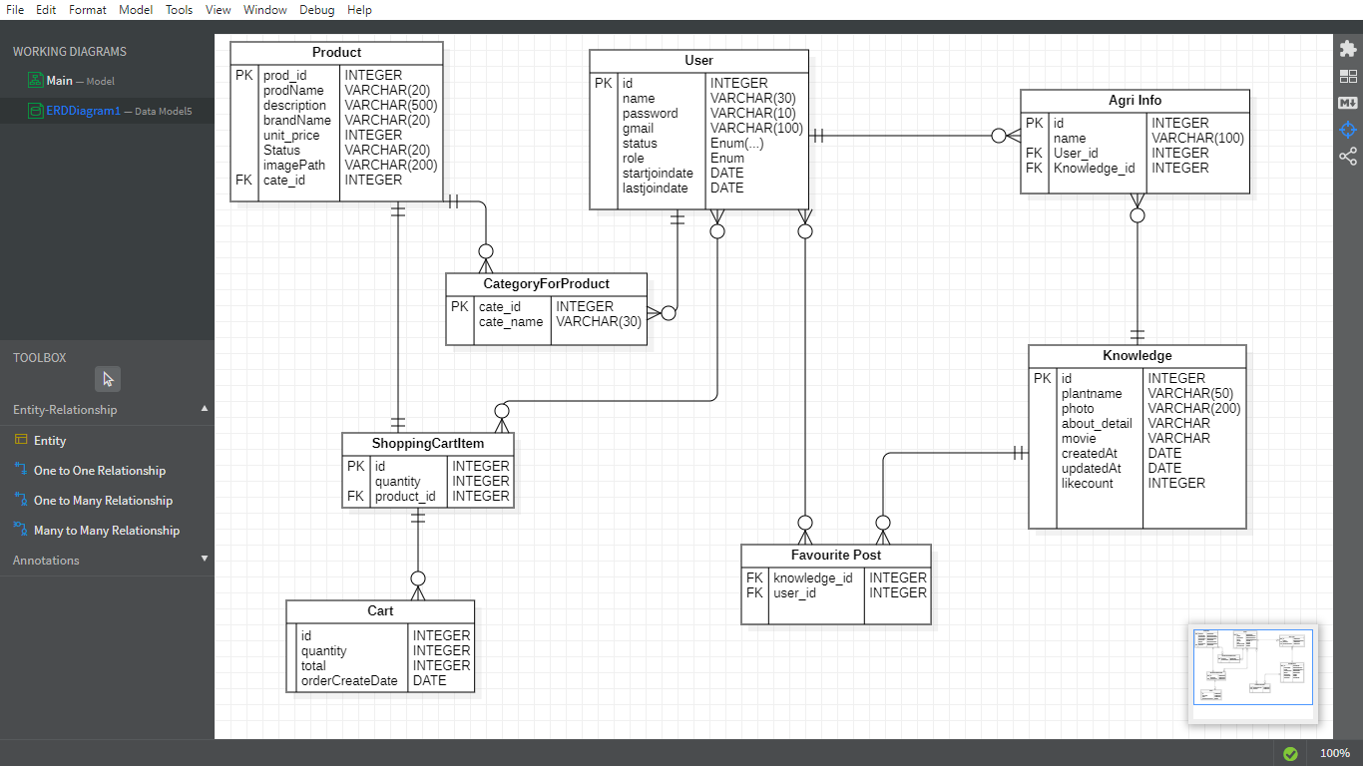
ER Diagram

Slide 7
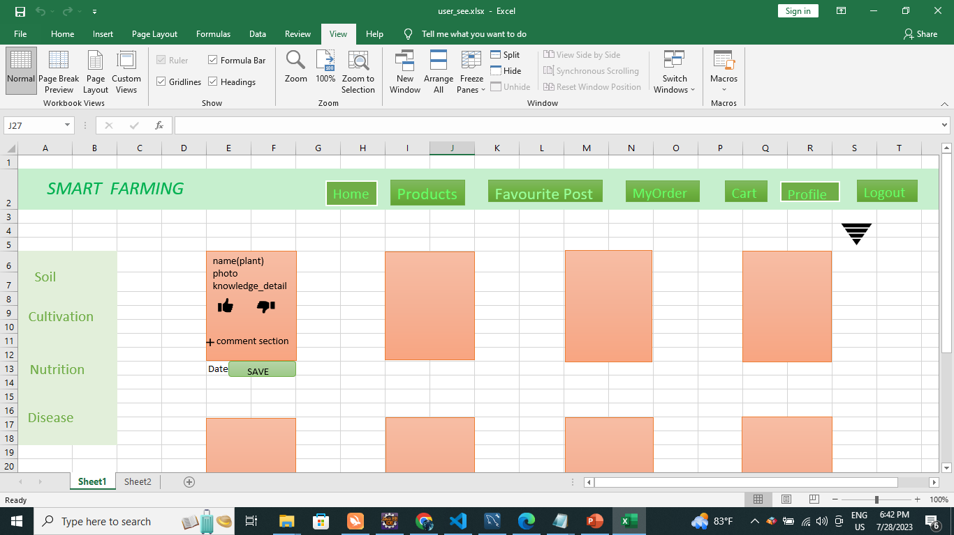

Slide 8
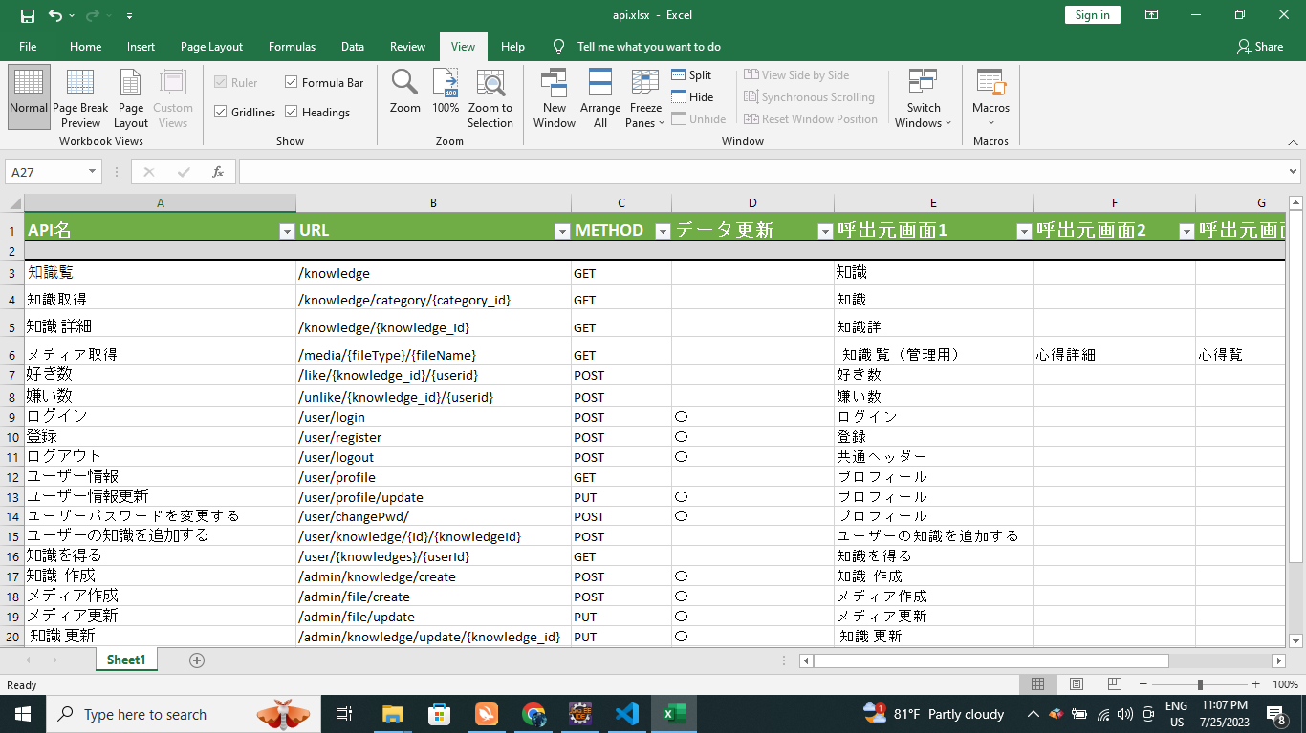

Slide 9
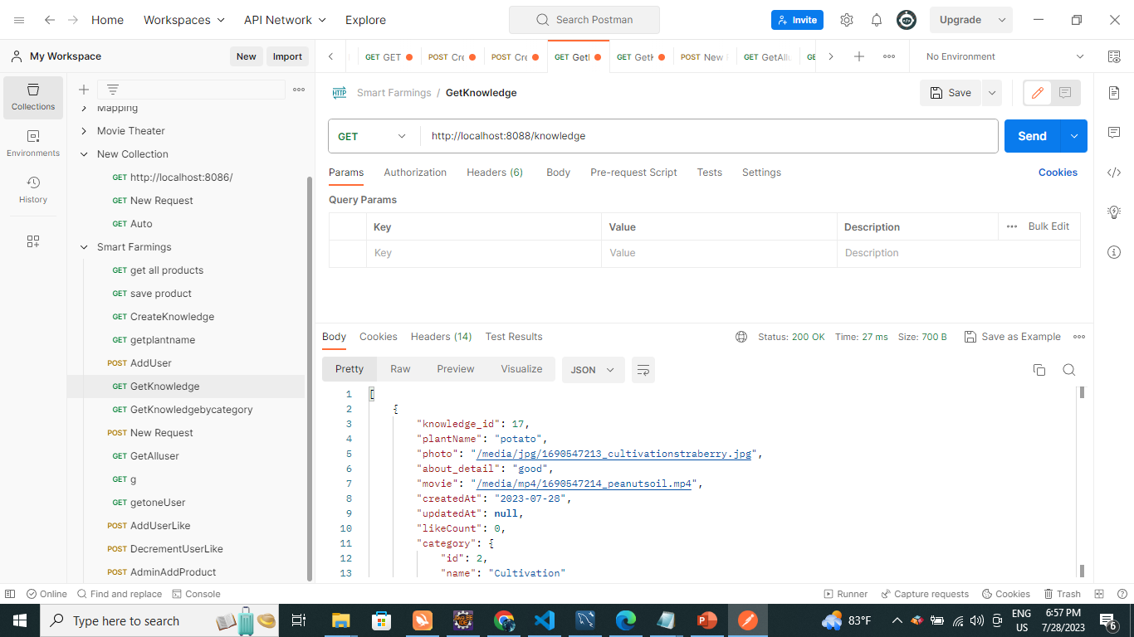
Testing

Slide 10
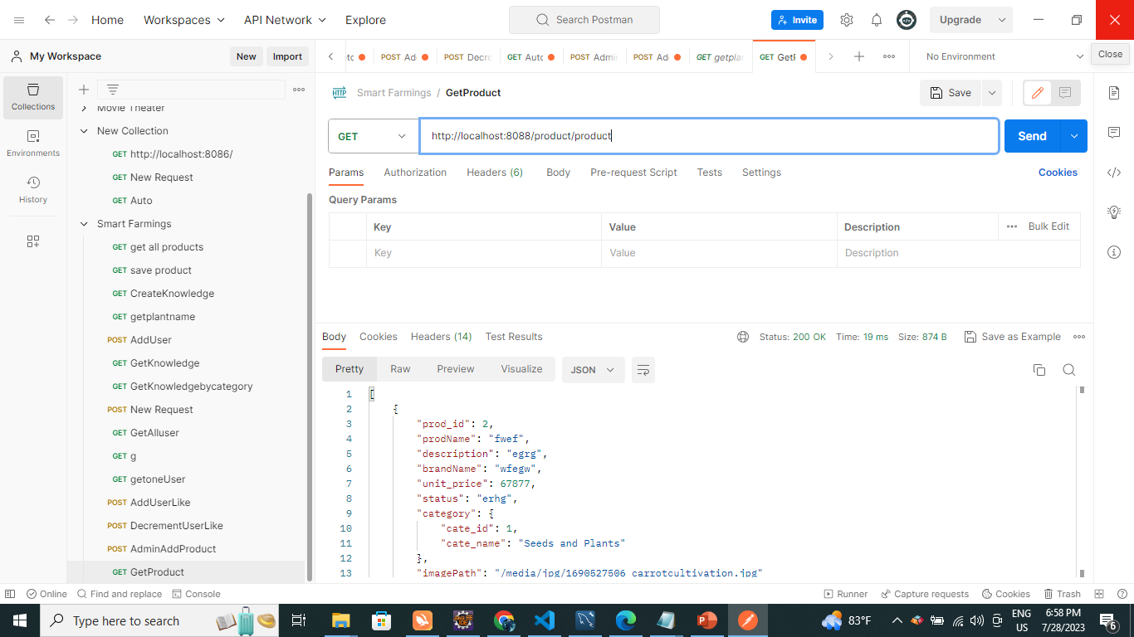

Slide 11
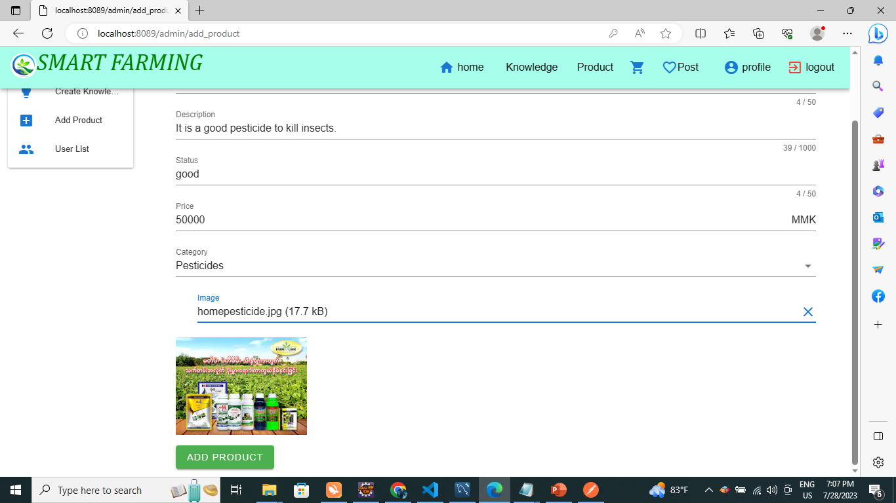

Slide 12
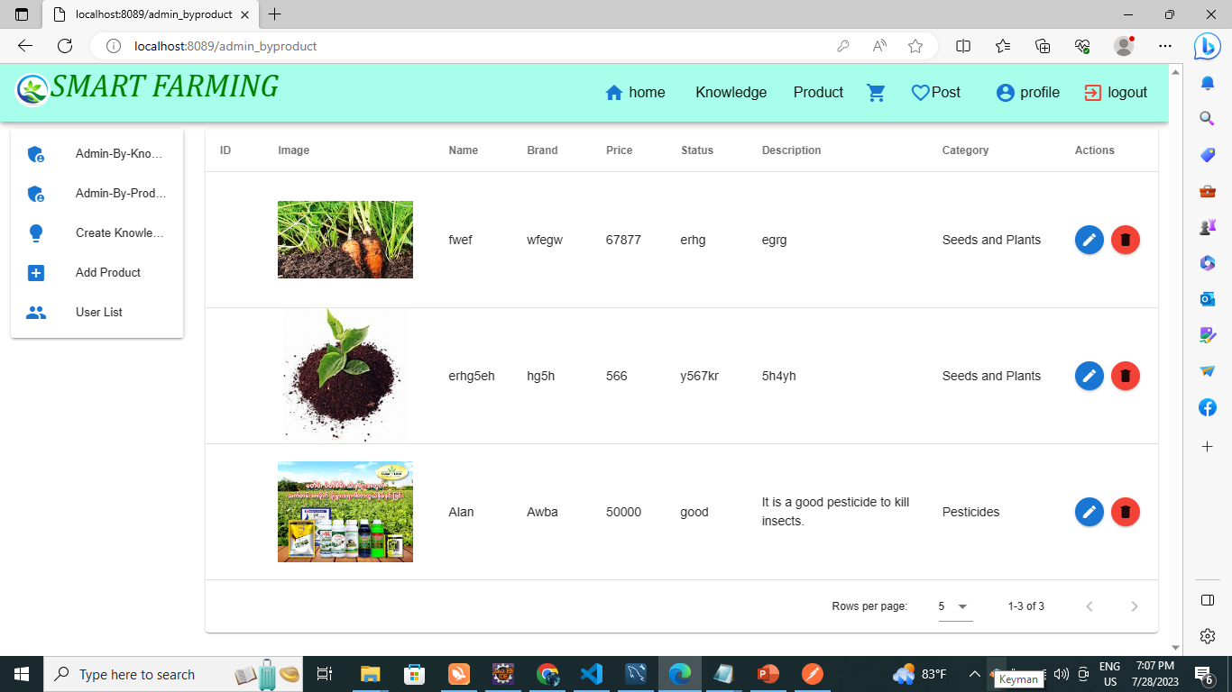

Slide 13
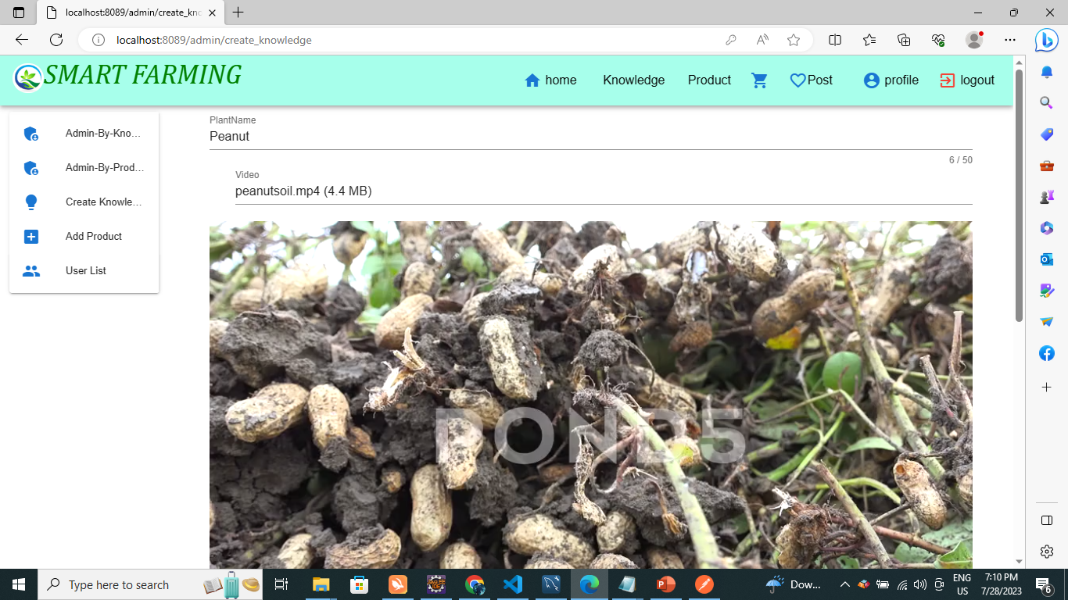

Slide 14
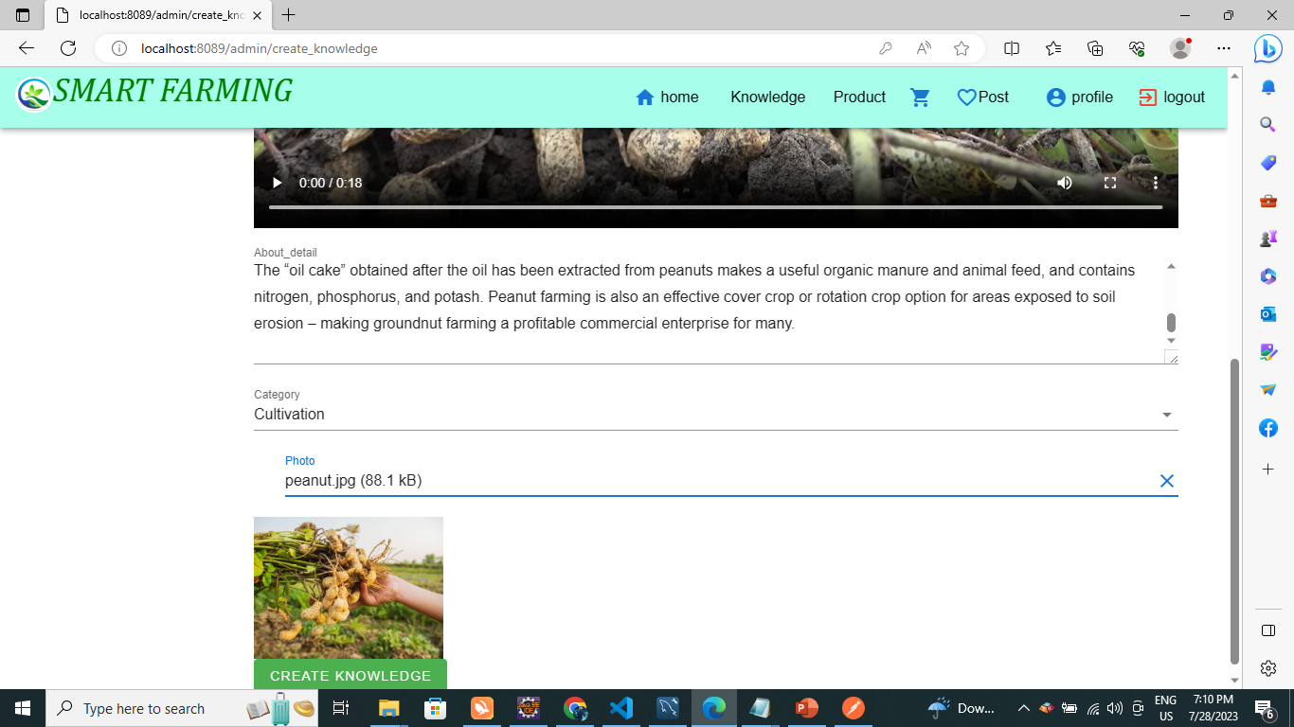

Slide 15
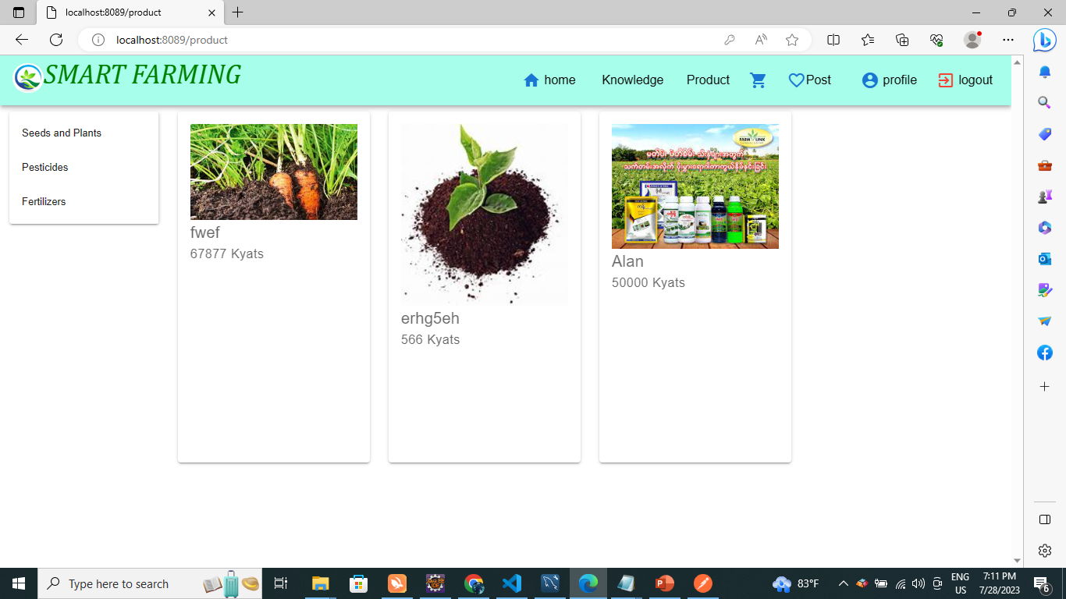

Slide 16
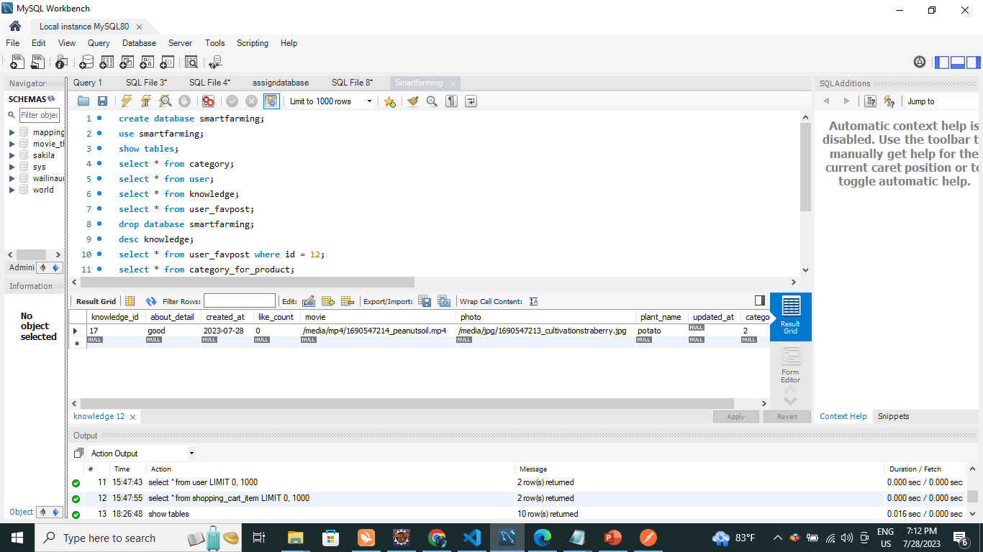

Slide 17
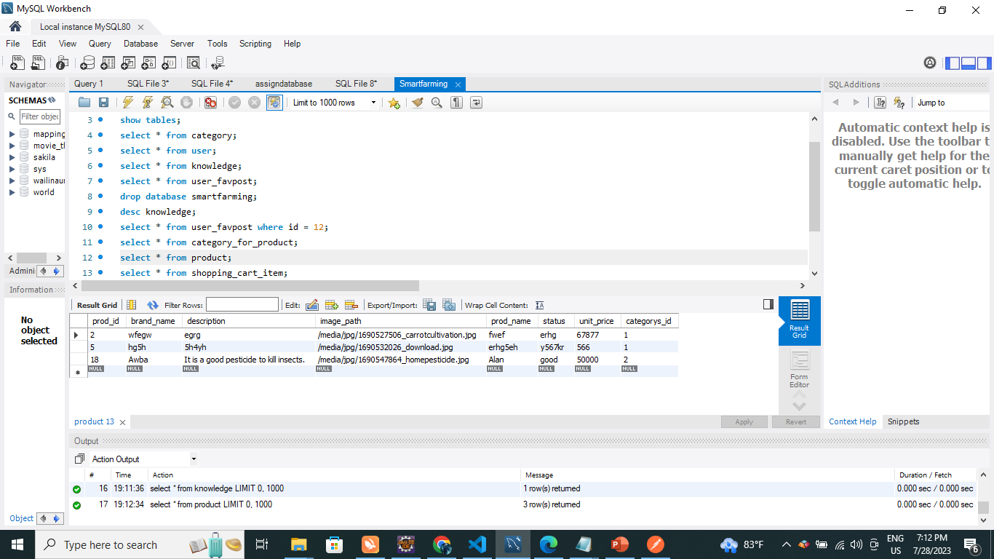

Slide 18
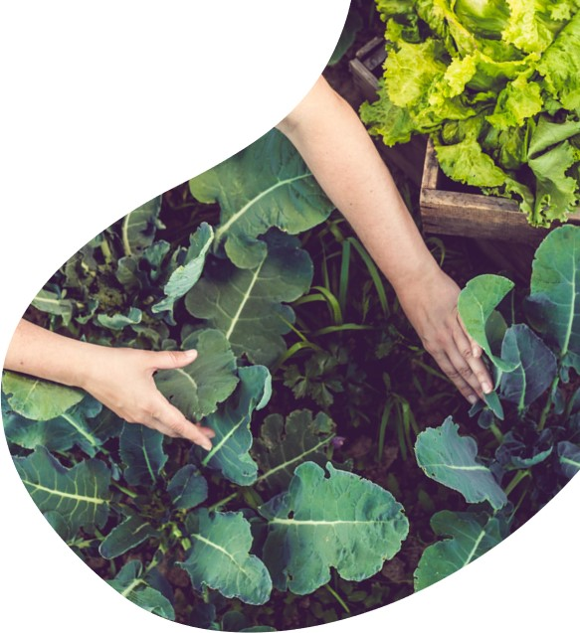
Summary
Farming is growing crops and
Keeping animals for food and raw materials.Farming is a part of agriculture.So,we must care with smart farming for our world.Let go together to the better world.

Slide 19

thank you
29.7.2023
Presented by XIAN GROUP

